Slide 1
Web Scraping for Weather Data Collection and Analysis
Scraping Weather Data for Kolhapur, Mumbai, and Nagpur from Weather.com

Slide 2
Project Objective
Objective:
"The goal of this project is to scrape current weather data for three cities (Kolhapur, Mumbai, Nagpur) from the Weather.com website and save the data in a structured CSV file."
Purpose:
To practice web scraping techniques and demonstrate how to collect structured data from a website.

Slide 3
Website Chosen - Weather.com
Website Overview:
I chose Weather.com as the source because it provides detailed, real-time weather data for various cities worldwide.
Data to be Scraped:
Weather conditions for the cities of Kolhapur, Mumbai, and Nagpur.
Data Points Extracted:
High/Low Temperature
Wind
Humidity
Dew Point
Pressure
UV Index
Visibility
Moon Phase

Slide 4
Web Scraping Process
Step 1: Exploring the Website
First, I inspected the HTML structure of the pages for each city to locate the tags with weather data.
Step 2: Scraping the Data
Using Python libraries such as requests to fetch the page and BeautifulSoup to parse the HTML, I extracted the relevant data points.
Step 3: Saving Data to CSV
Once the data was extracted, I saved it into a CSV file using the csv library, ensuring each data point had a descriptive header.

Slide 5





Code Overview
Libraries Used:
Requests: To make HTTP requests to the website.
BeautifulSoup: To parse and extract HTML content.
CSV: To save the data in a structured CSV format.
Code
# For Kolhapur

Slide 6

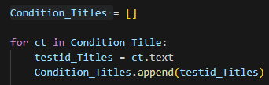
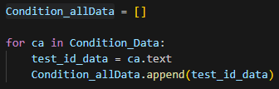
I Did Same Coding For Mumbai and Nagpur Aswell

Slide 7



Slide 8
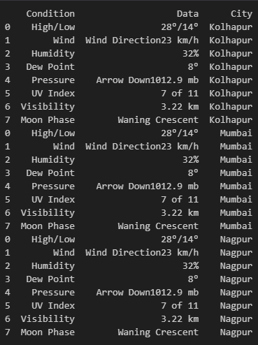

Slide 9
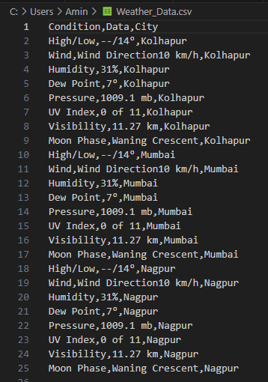

Slide 10
Results
Weather Data for Kolhapur, Mumbai, and Nagpur was successfully scraped.
The data includes :
High/Low Temperature
Wind
Humidity
Dew Point
Pressure
UV Index
Visibility
Moon Phase
The data is stored in a CSV format for easy analysis.

Slide 11
Thank You

